Slide 1

The influence of COVID-19 on different types of crime
tbc
Group 6
https://github.com/kongpeiyen/crime-rates
Notes:
-just the research question

Slide 2
Table of contents
Context and motivation
Explanation of variables
Sources of data
Methods of analysing data
Data visualisation and website
Limitations

Slide 3



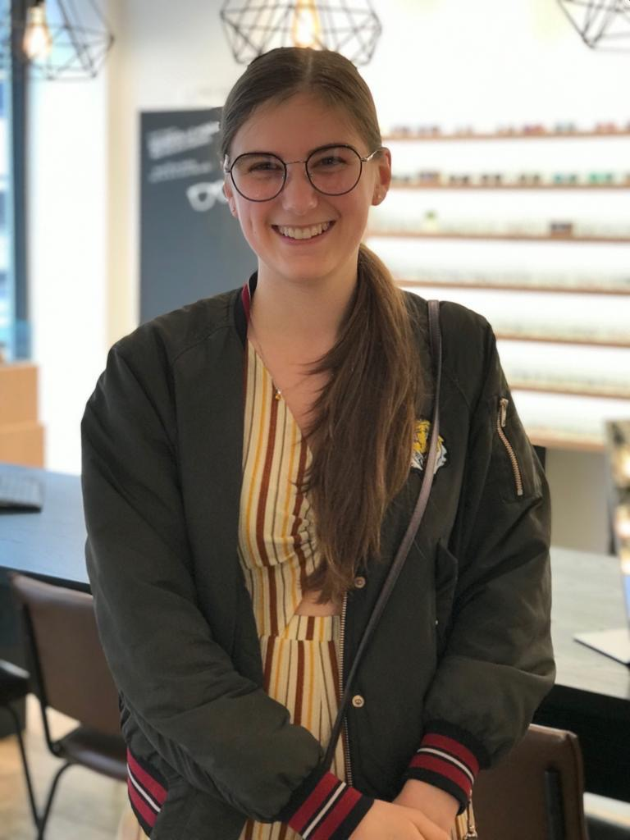

Meet our team
Jana
Team Leader
context
Camilla
Research and Data analysis
Tiphaine
Research and website design
Alaric
Data analysis and visualisation
Pei Yen
Website design and data visualization

Slide 4
Our research question:
“How did burglary, sexual offences and drug offences change after the outbreak of covid19 in London?”

Slide 5


Context
The outbreak of coronavirus is “the largest criminological experiment in history” (Stickle and Felson 2020)
Government resources are concentrated on containing the virus, protecting their populations and searching for a vaccine, so what does this mean for crime?
Notes:
Maybe too much info for slides
Just keywords for slides (write our script separately)
JANA

Slide 6


Motivation of this study
LITERATURE GAP
Few studies on specific types of crime
No study on this topic focusing on london
SOCIAL RELEVANCE
Insights for policy force and policy makers
Raising awareness
Notes:
“ These decisions of pretrial release, probation, and parole have traditionally been addressed daily, but they could well take a different form in the context of the virus. The concern about contagion puts additional weight favoring release in order to reduce the density in the inevitably crowded prison or jail environments.” (Miller and Blumstein 2020)

Slide 7
Covid-19 and burglary
RESIDENTIAL BURGLARIES
supposed to decrease because of increase in guardianship
Commercial BURGLARIES
supposed to increase because of decrease in guardianship
However, some previous research found different results in other cities
Notes:
Camilla
Commercial vs residential
Study by Ashby (2020) found that in Chicago, Los Angeles, and Memphis the frequency of burglary was around half compared to what it was expected to be if covid19 never occurred. However, Austin, Louisville and Minneapolis did not experience a decrease. Moreover, out of the 11 cities that saw a decrease in burglary, in only one was the difference statistically significant. . However, Austin, Louisville and Minneapolis did not experience a decrease. Moreover, out of the 11 cities that saw a decrease in burglary, in only one was the difference statistically significant.
A study done by Hodgkinson and Andresen looked found an increase in commercial burglaries, since owners and employees were not able anymore to act as capable guardians, while residential burglary showed no obvious change.
The inconsistency of this trend suggests that more research should be conducted around this topic.

Slide 8


why sexual offences?
1. NEWS COVERAGE AND SOCIAL MEDIA AWARENESS CAMPAIGNS
2. Feminist motivation
societal upheavals influence women’s rights
reported a rise of domestic abuse during lockdown

Slide 9

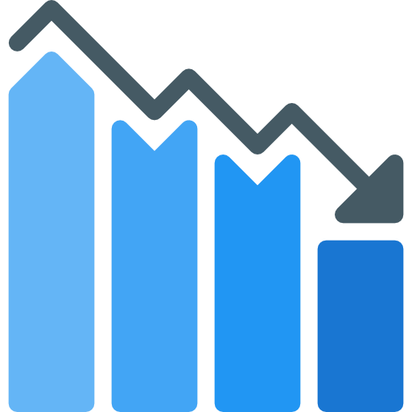
Covid-19 and drug offences
Drug use on the rise for 10 years
COVID impacts unemployment which in turn increases drug use
Decreasing in the UK for the past 5 years
Augmentation only in small towns (≠ London)
→ This makes the variable a shifting point for crime
Notes:
Tiphaine

Slide 10

Data sources
Datasets from Metropolitan Police
It shows the monthly level of crime per borough per crime type. (.csv)
Not many sources record the number of crimes apart from the Police.
Important note: this is our only data source!!!
Notes:
https://www.finder.com/uk/london-crime-statistics
Alaric - acknowledge limitations and try to find another source, address the issue

Slide 11
Methods of analysing our data
1. Descriptive statistics
Distribution
Mode, median, mean
2. Predictive model
How crime would have been in 2020 without COVID-19?
3. STATISTICAL SIGNIFICANCE
Calculate a p-value for the difference between predicted and actual values
Notes:
Camilla
Mapping in visualization

Slide 12
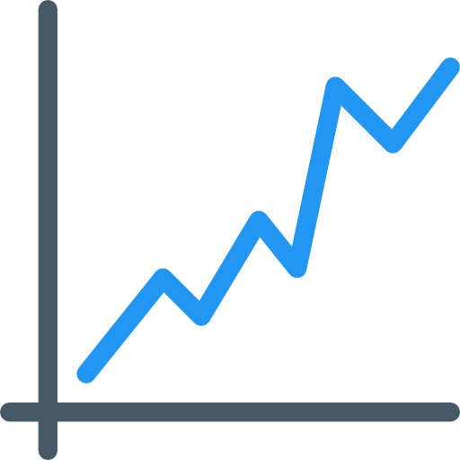
Data visualization
Connected scatter plots for each variable to see the trend over time.
Boxplot to check for outliers
Normal distribution
One single choropleth map
Using Folium
Notes:
Scatter plot ?
Alaric
See drive
Mapping - explain how we will do this, mention program we are using
Trend over time

Slide 13
limitations
Predictive methods are never totally accurate
Many crimes are not reported and particularly the number of unreported sexual offences has increased during the pandemic
We are still living the pandemic → not much hindsight
Confounding variables
Notes:
Everyone on their own part

Slide 14
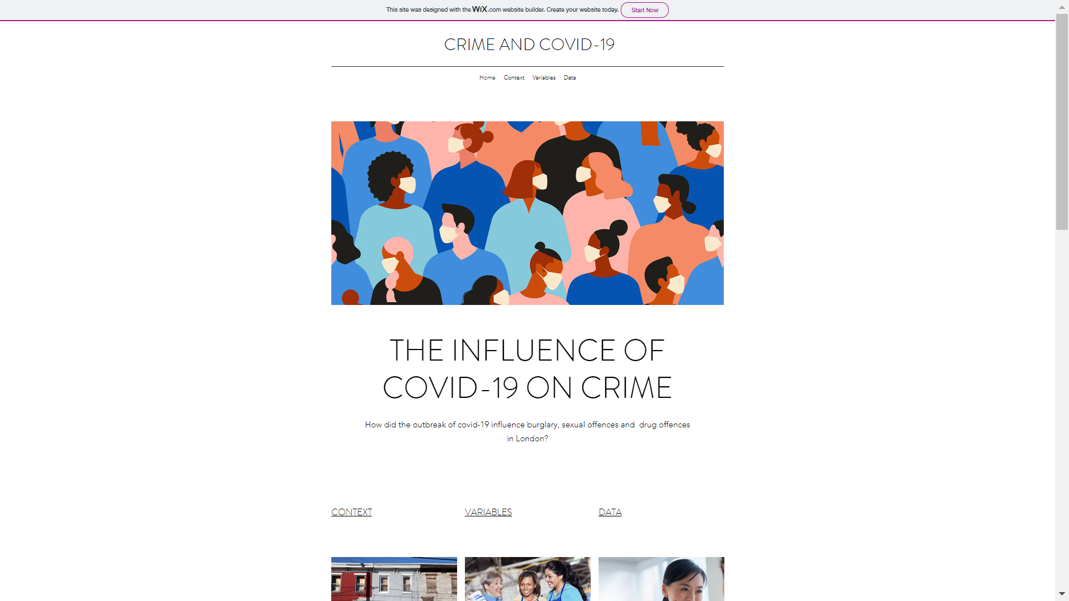
Sneak Peek of our website...
Link: https://oudinalaric.wixsite.com/crimeandcovid?fbclid=IwAR2VgqJwp48k-LWLd4G8tI8UxwmnBZr2_V2tHXPevlCLFEFOsxZkBJNo2b4
Notes:
Pei

Slide 15
Bibliography
Miller, J. and Blumstein, A. (2020) "Crime, Justice & the COVID-19 Pandemic: Toward a National Research Agenda", American Journal of Criminal Justice, 45(4), pp. 515-524. doi: 10.1007/s12103-020-09555-z.
Sexual offences Act 2003. (c.42). [Online]. Parliament of the United Kingdom [Accessed 10 November 2020]. Available from: http://www.legislation.gov.uk/
Stickle, B. and Felson, M. (2020) "Crime Rates in a Pandemic: the Largest Criminological Experiment in History", American Journal of Criminal Justice, 45(4), pp. 525-536. doi: 10.1007/s12103-020-09546-0.
Townsend, M. (2020) ‘Revealed: surge in domestic violence during Covid-19 crisis’ the Guardian, 12 April Available at: https://www.theguardian.com/society/2020/apr/12/domestic-violence-surges-seven-hundred-per-cent-uk-coronavirus (Accessed: 14 November 2020).
United Nations Office On Drugs And Crime (2020). “Covid-19 and the drug supply chain: from production and trafficking to use”. pp. 23-29. Available at: https://wdr.unodc.org/wdr2020/field/WDR20_BOOKLET_1.pdf [Accessed 14 November 2020].
United Nations Office On Drugs And Crime (2020). “Effect of COVID-19 on drug markets”. pp. 7-14. Available at: https://wdr.unodc.org/wdr2020/field/WDR20_BOOKLET_1.pdf [Accessed 14 November 2020].
Dahlgreen, W., 2019. Drug crime mapped. BBC News, [online] Available at: https://www.bbc.co.uk/news/uk-48343369 [Accessed 14 November 2020].
Notes:
Everyone

